Slide 1

Automated Irrigation system Applied in Crop Farming
(ITC’s Green House)
Lecturer : HEL CHANTHAN
Student : PROEUNG BUNRONG (e20191346)
Department : I4 GTR

Slide 2
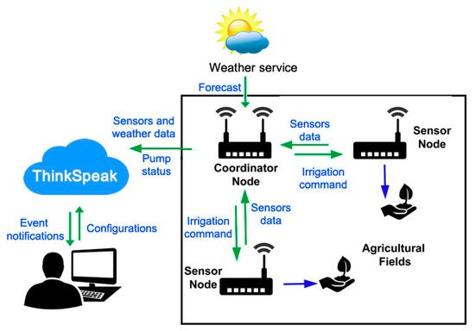
Project analysis slide 4
Project Analysis
The Composition of the system
The system is composed mainly of three parts:
Cloud Platform, Coordinator Node, and Sensor Nodes …

Slide 3
Project analysis slide 10
Project Analysis
Planning for first month
Week 1 6 Aug – 13 Aug | Week2 14 Aug – 20 Aug | Week3 21 Aug – 27 Aug | Week4 28 Aug – 3 Sep
Researching Code and test with dht11 Create charnel Thingspeak and testing. | To understand problem of code, Using Wi-Fi with username Combine code with coordinator and testing then send data to Thingspeak. | Collect data from Greenhouse send to Thingspeak And show all the result of Temperature (T1+T2) Or another Sensor on thingspeak. | Need to Complete planning of first month and continue working for second month to use Camera in greenhouse.
Missing: testing some error, problem to understand something in code

Slide 4
Project analysis slide 3
Project Analysis
Outline
System Working
Code Coordinator
Code NodeMCU
ThingSpeak and LCD
Export Value

Slide 5
Project analysis slide 3
Project Analysis
System Working
Collecting data : Temperature, Humidity, Moisture, Solar Radiation from ITC GREENHOUSE. We have two sensor nodes working in Greenhouse and a Coordinator collected data from those nodes sending data to ThingSpeak using NodeMCU by delay 2minutes.

Slide 6
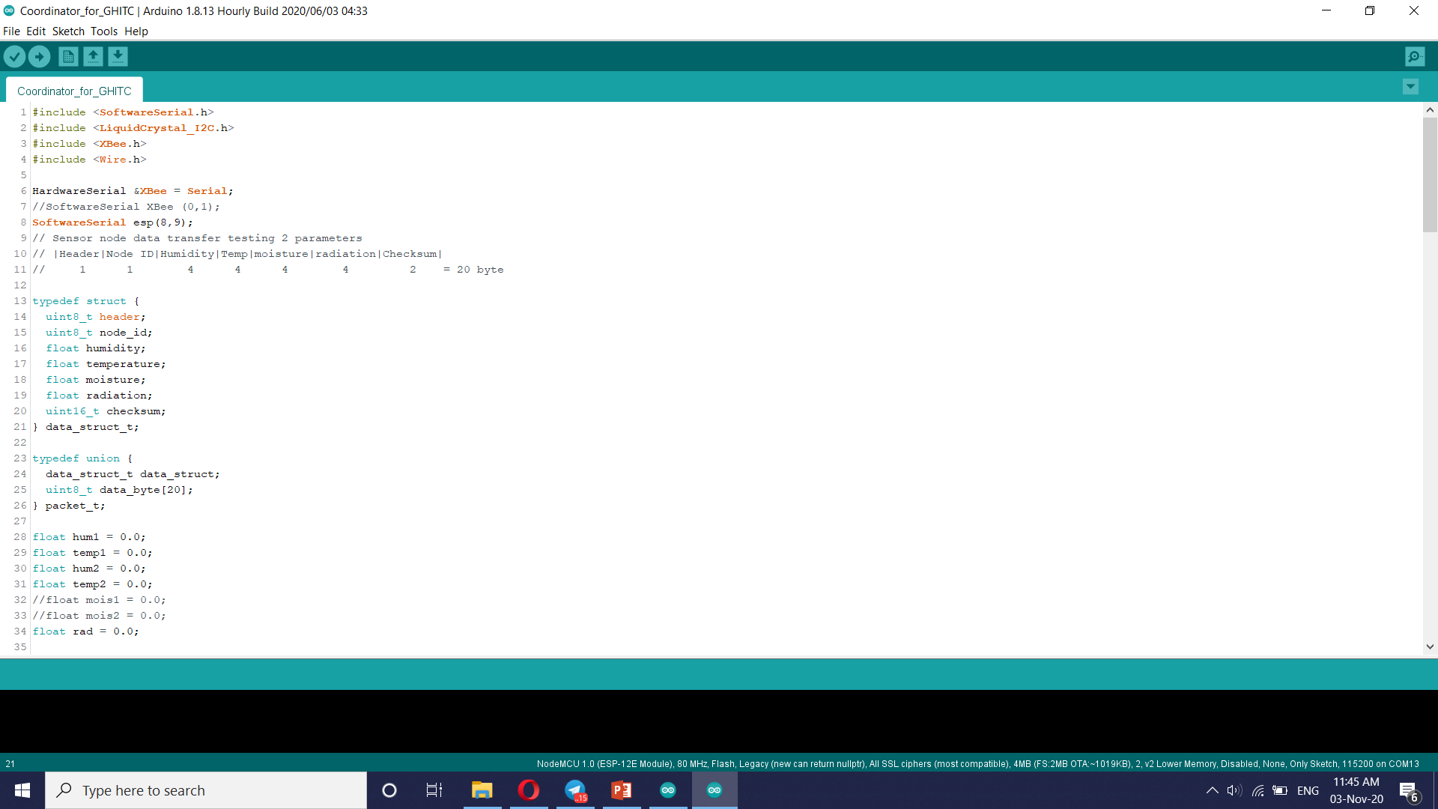
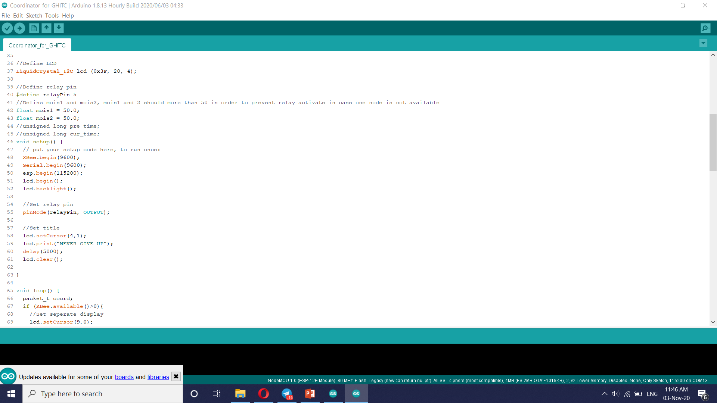
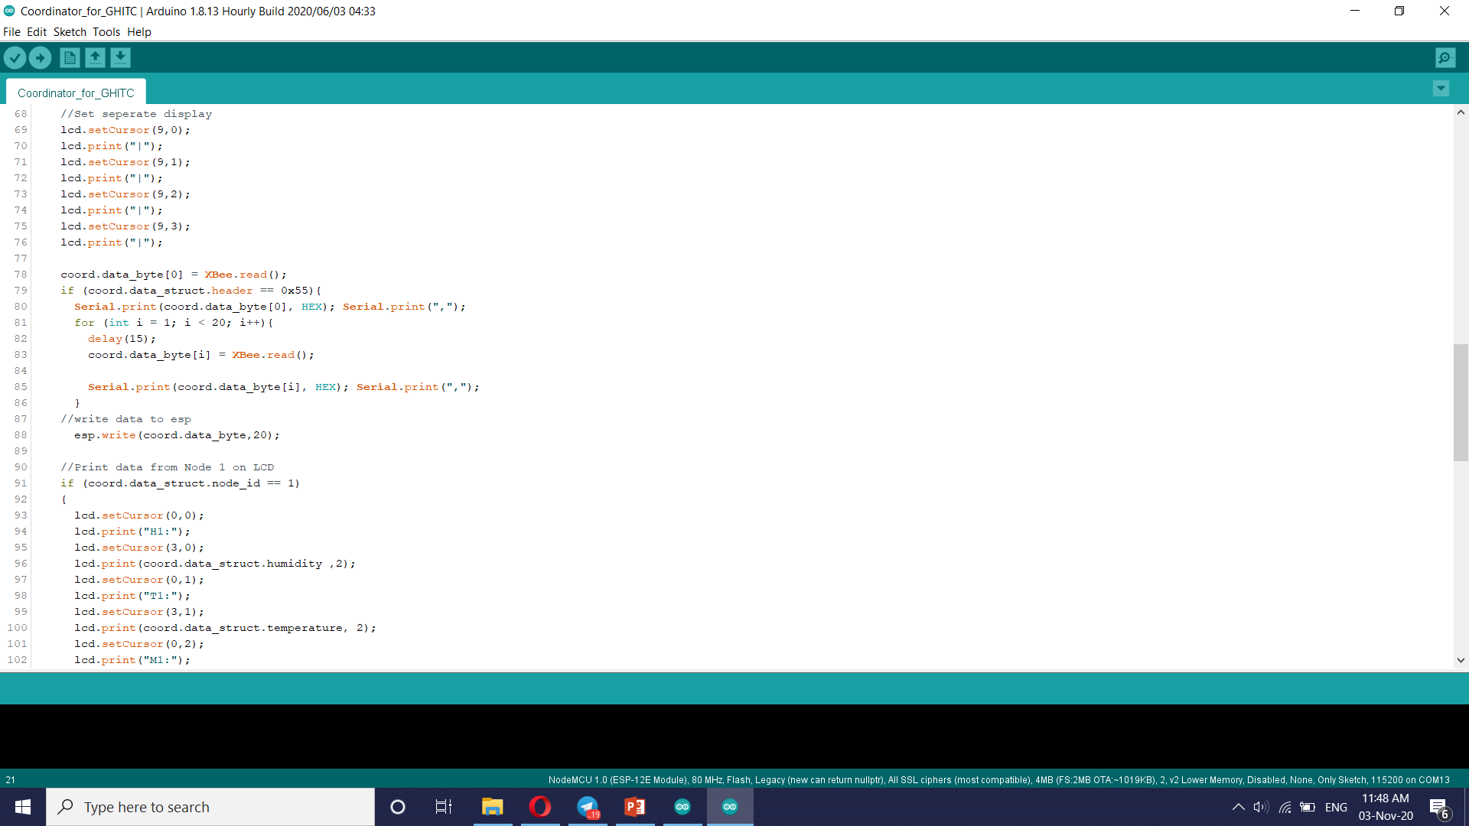
Project analysis slide 3
Project Analysis
Code Coordinator

Slide 7
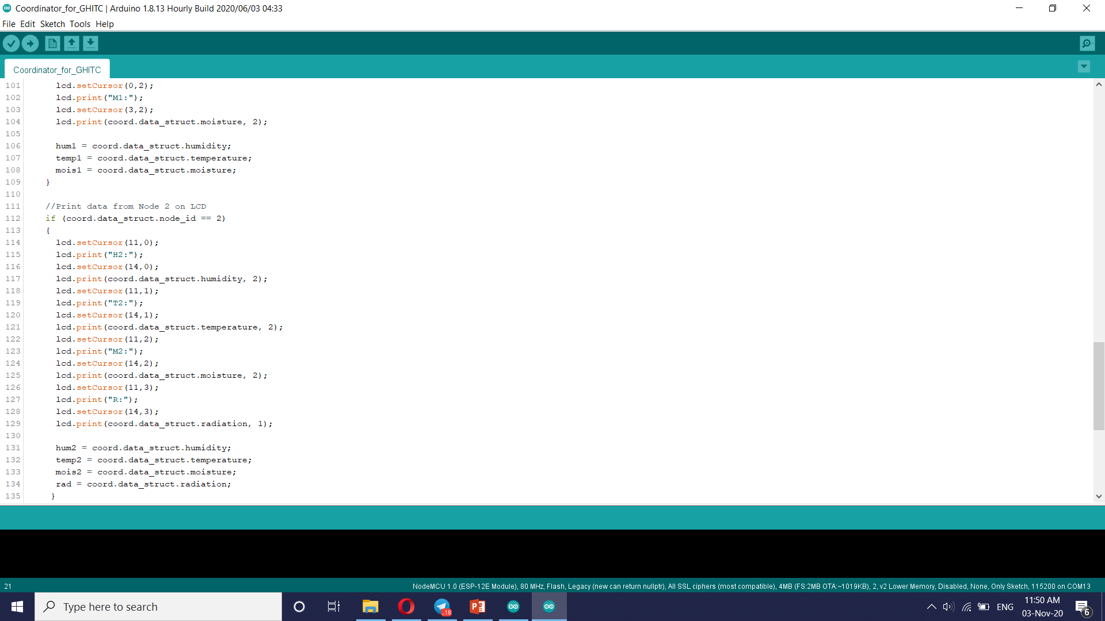
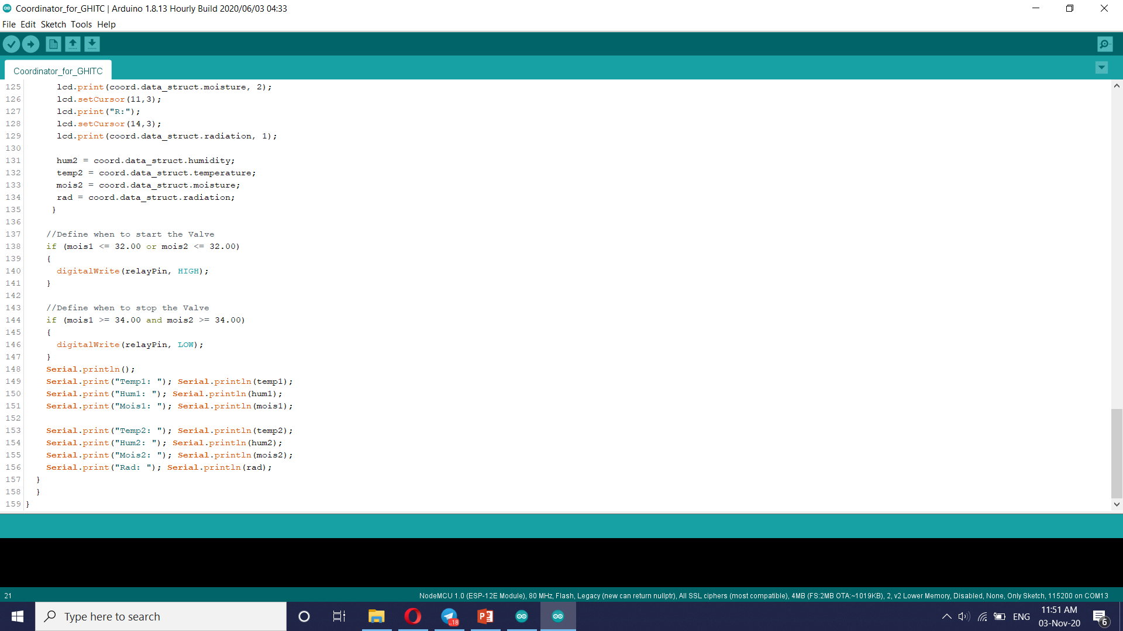
Project analysis slide 3
Project Analysis

Slide 8
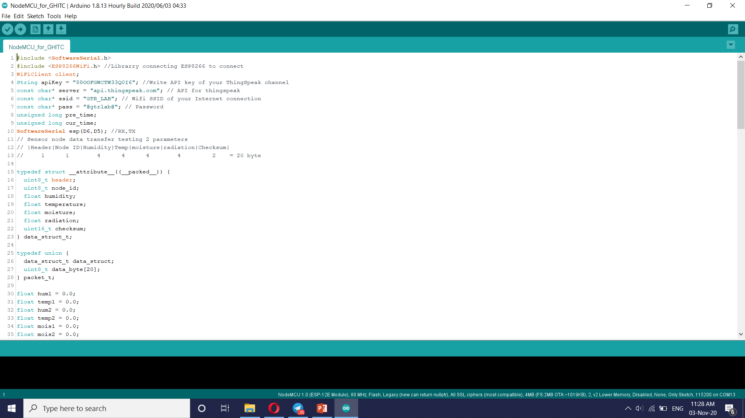
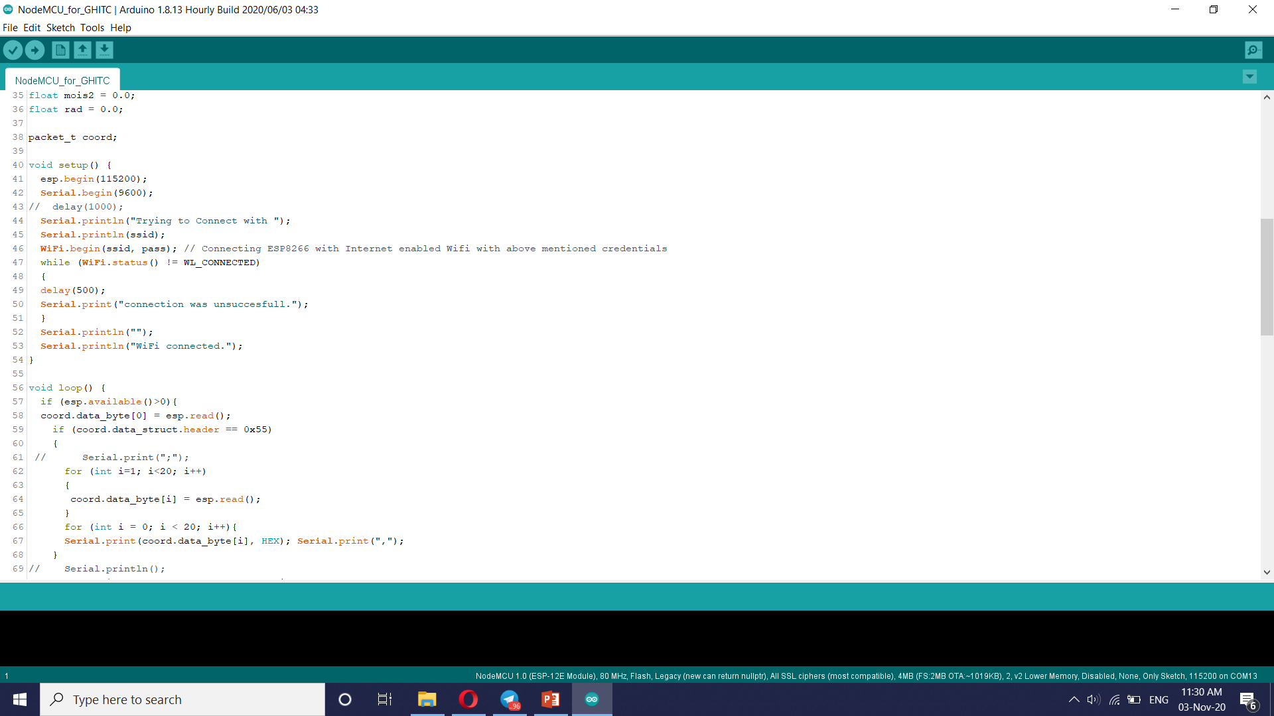
Project analysis slide 3
Project Analysis
Code NodeMCU

Slide 9
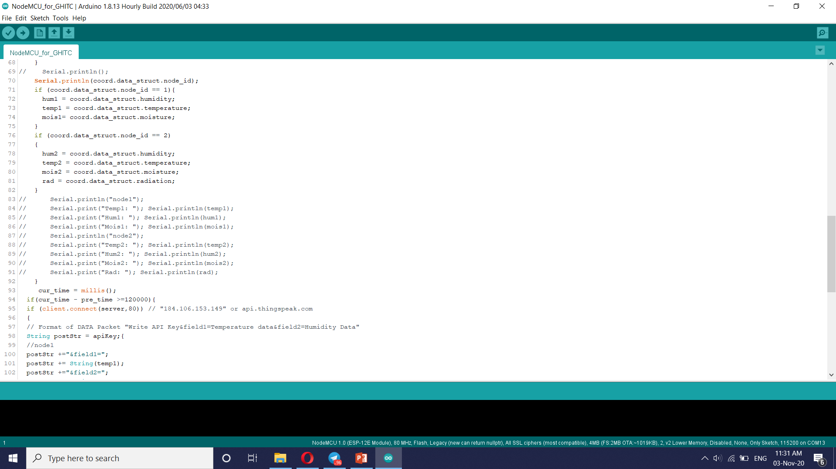
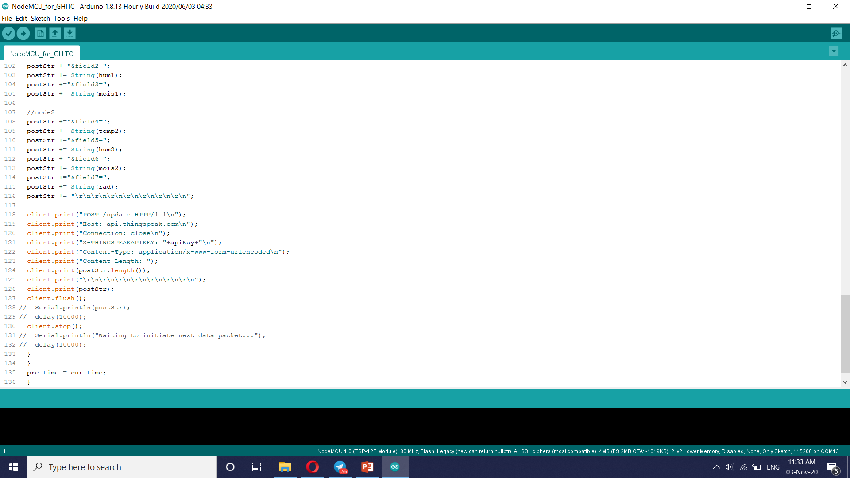
Project analysis slide 3
Project Analysis

Slide 10
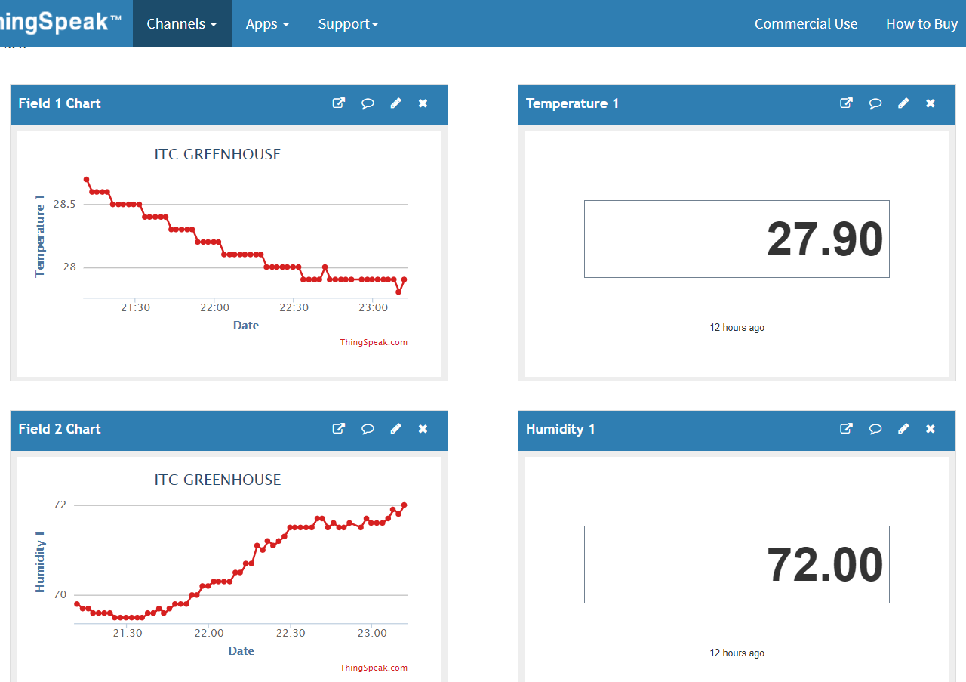
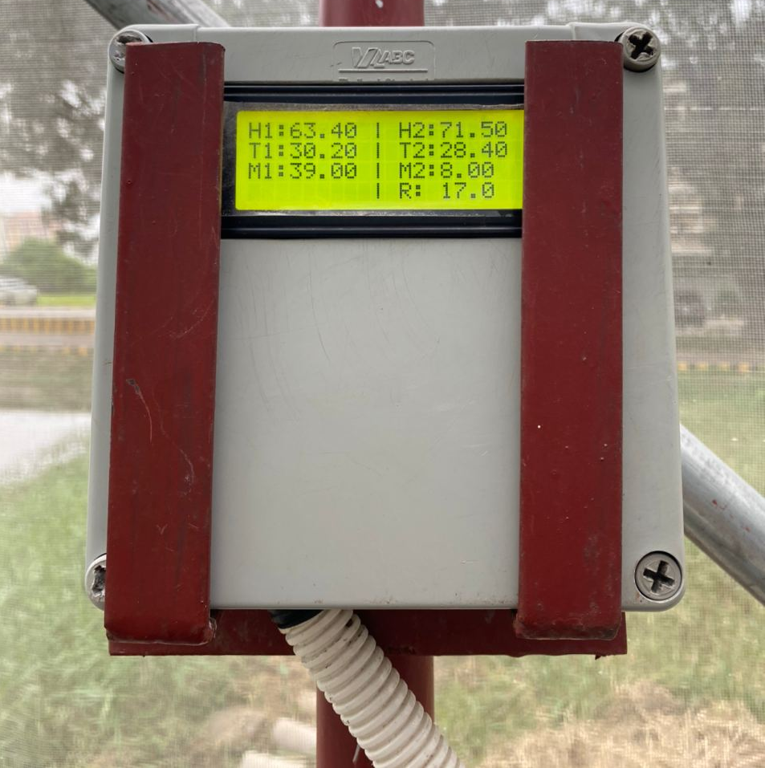
Project analysis slide 3
Project Analysis
ThingSpeak and LCD

Slide 11
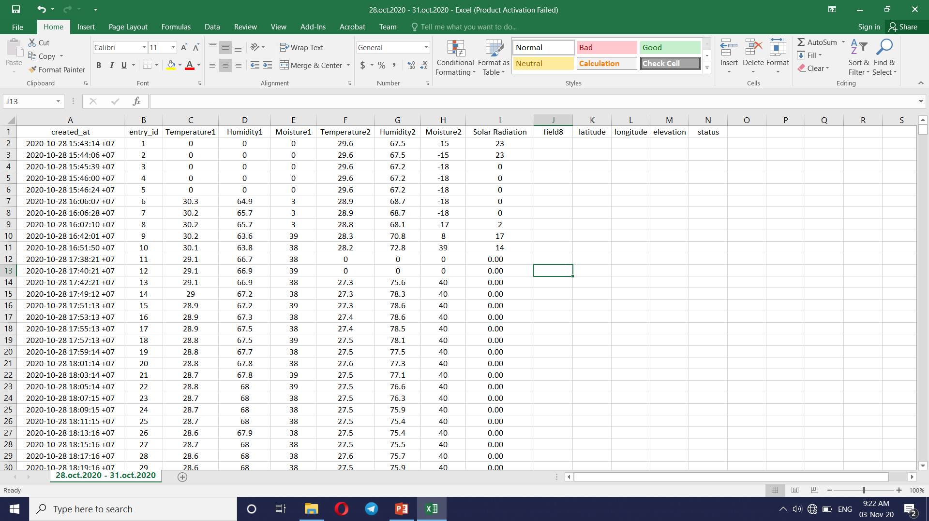
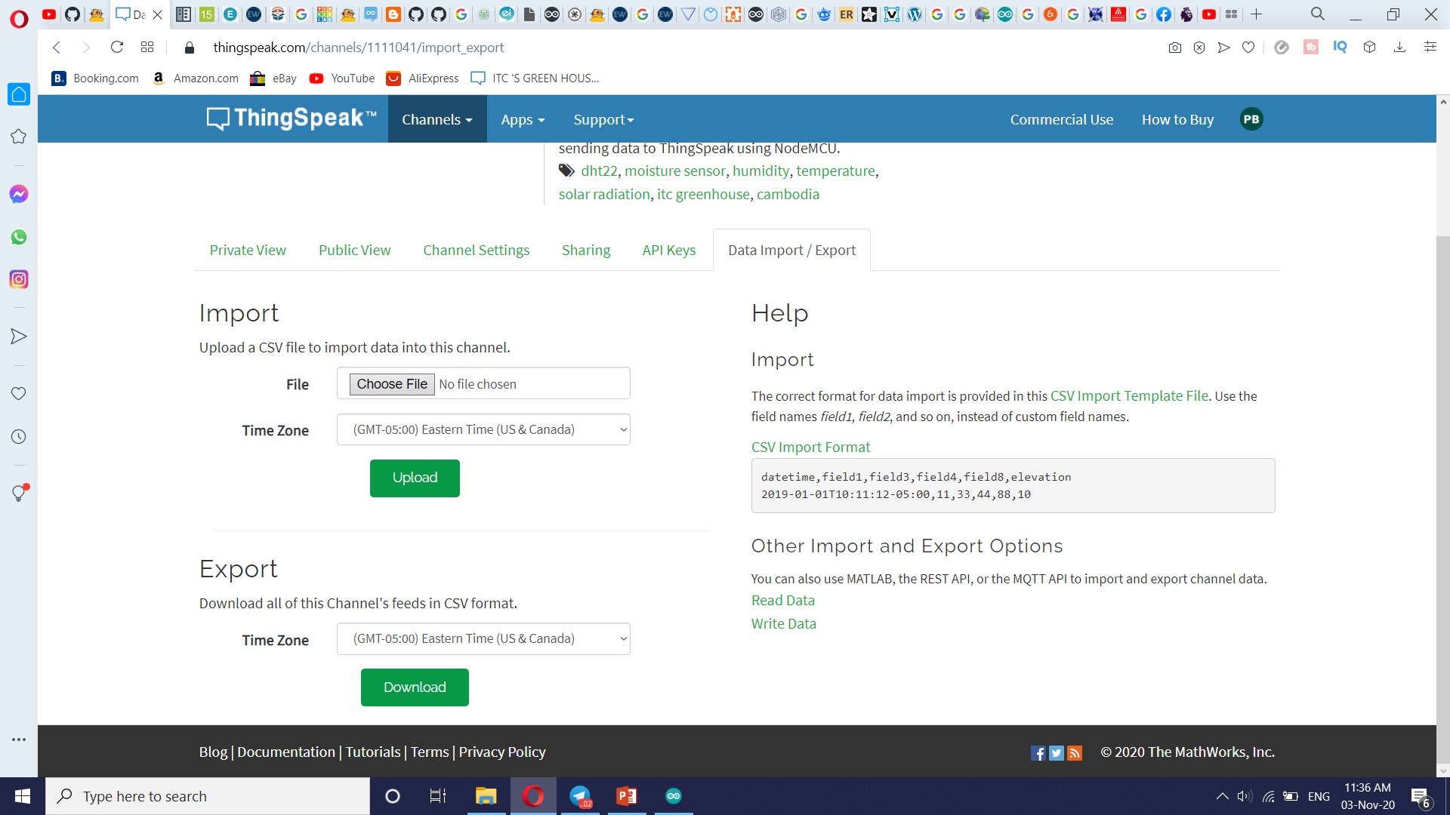
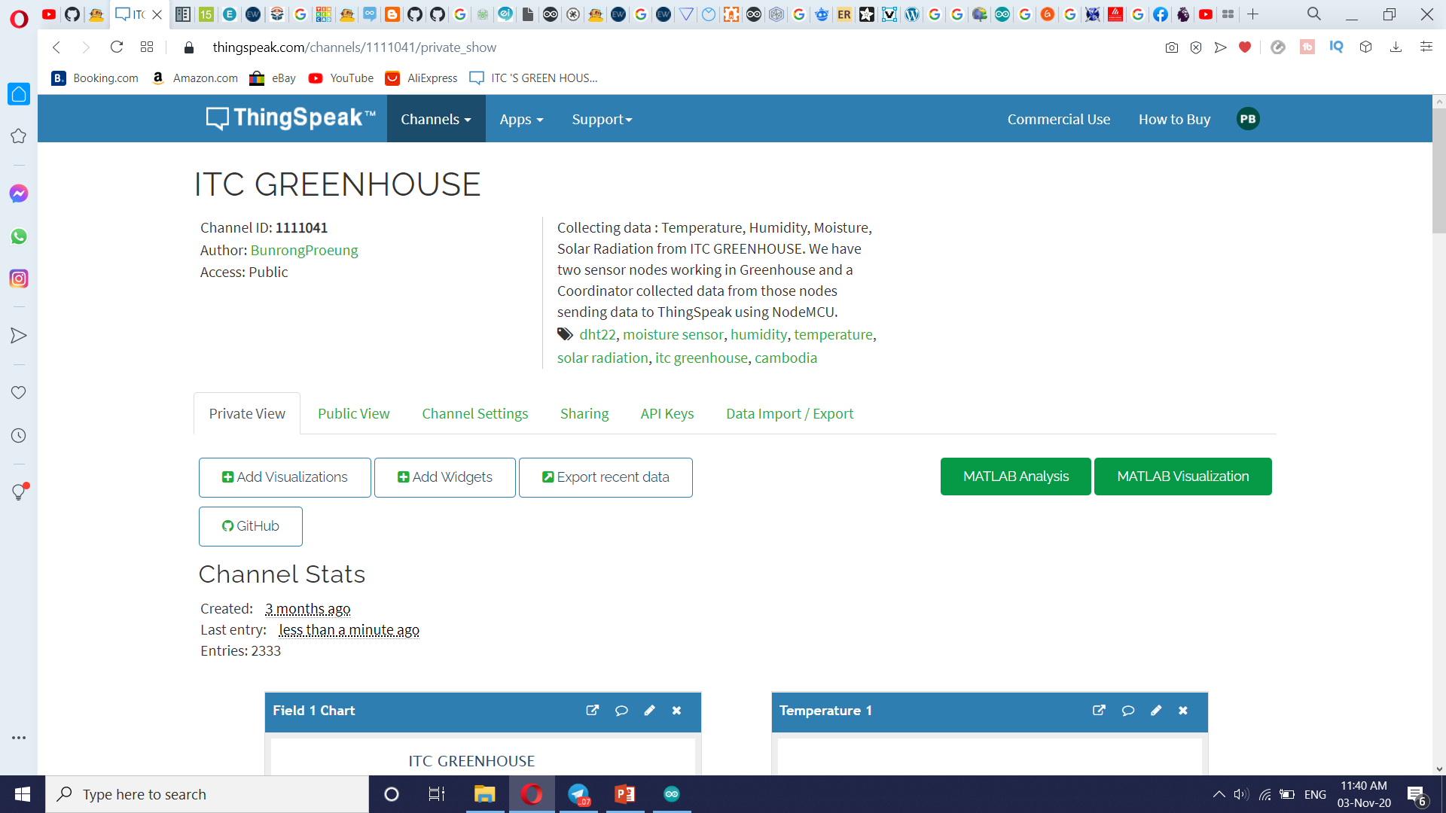
Project analysis slide 3
Project Analysis
Export Value

Slide 12
Thank You

